Slide 1

Mountain Survival TeaM Plan Neresha Miller CTEC 298 Professor Bemley

Slide 2

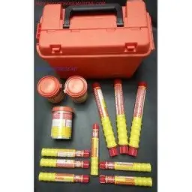


Survival items
Compass – To navigate and find direction in the mountains
Crate of Bottled Spring Water – Essential for hydration and survival
Bag of 6 Large Blankets – To stay warm and prevent hypothermia
Box of Distress Signal Flares – To signal for rescue or alert nearby people

Slide 3
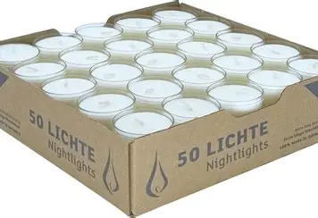
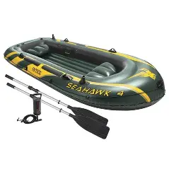
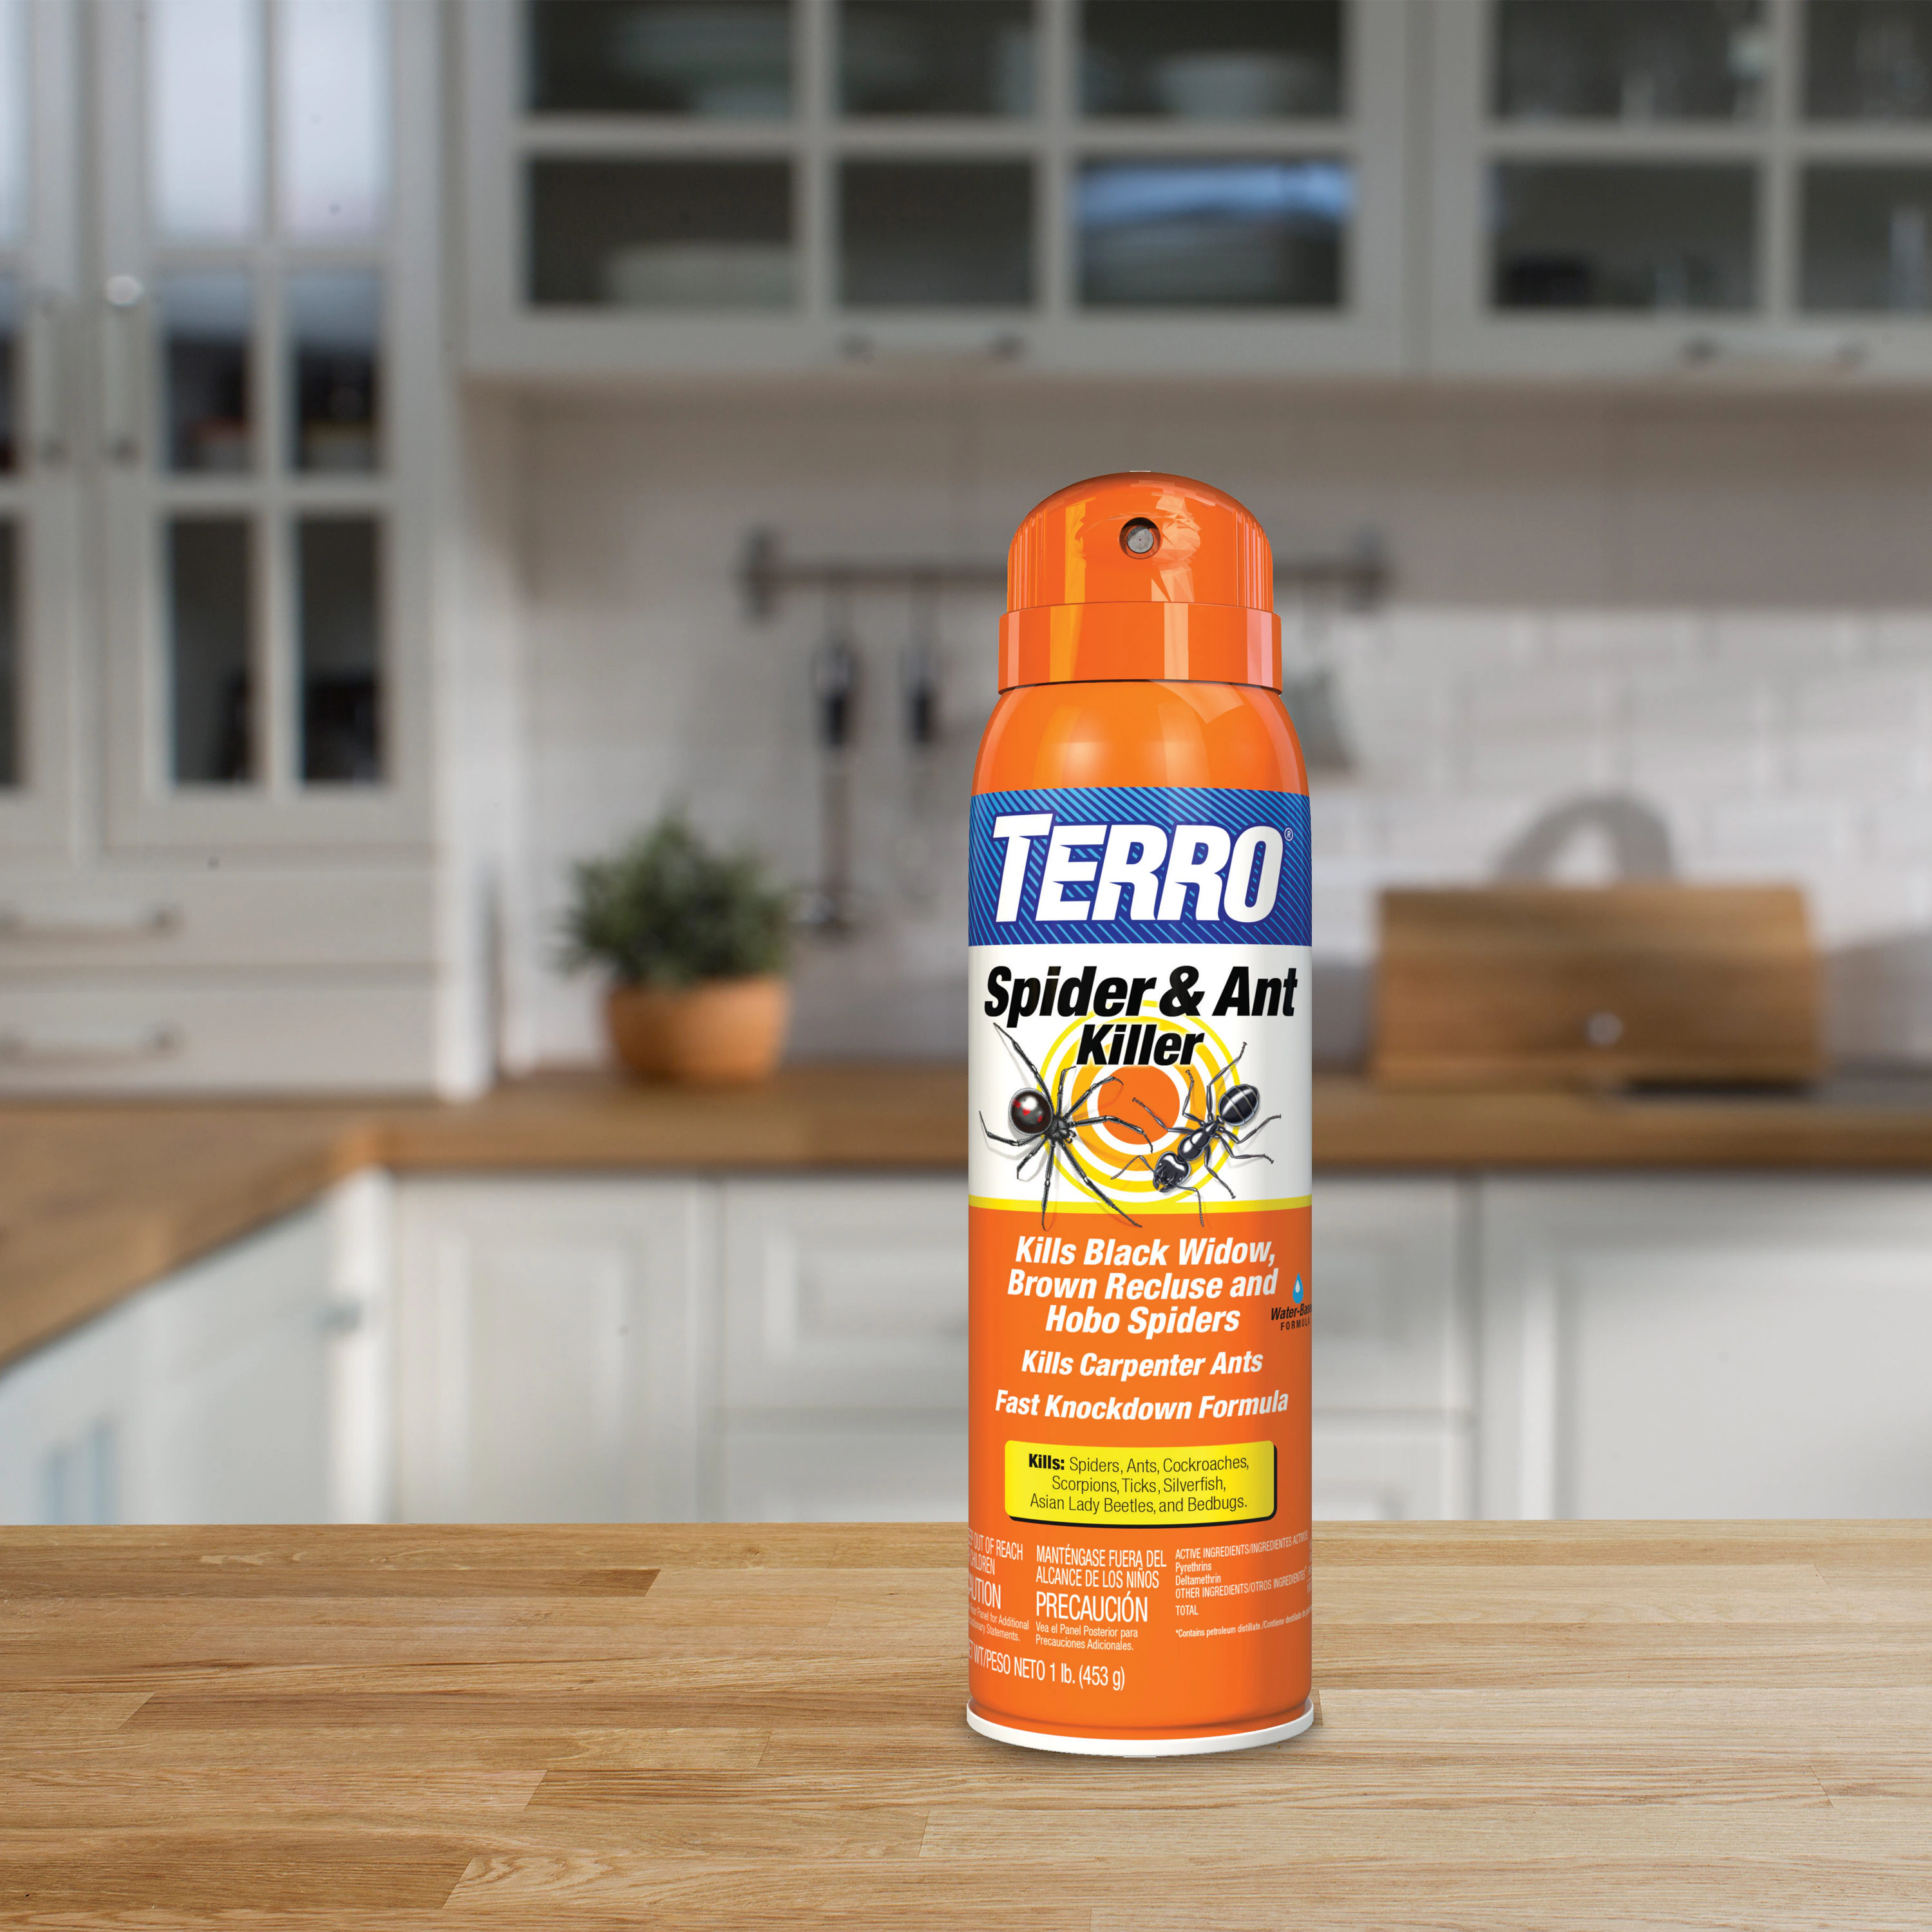
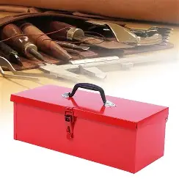
Survival items
5. Small Toolbox (hammer,screwdriver set, adjustable wrench, hacksaw, large pen-knife) – Useful for building shelter, repairs, and protection
6. Box of 50 Night-Light 6hr Candles – Provide light, a little heat, and comfort during the night
7. Inflatable 4-person Life Raft – Can be used for shelter, protection from the cold ground, or as a signal if brightly colored
8. Large Full Aerosol Can of Insect Killer Spray – For protection against insect that can bite or spread disease.

Slide 4

WHy I CHOse these Items
I selected these items because they cover the main survival priorities: water, warmth, shelter, safety, navigation, and signaling. The water is most critical for staying alive. Blankets and candles help maintain body temperature in the cold mountain air. The toolbox gives me the ability to build or fix things, while the compass and flares help with direction and rescue. The raft offers shelter, and the insect spray provides protection and comfort.

Slide 5
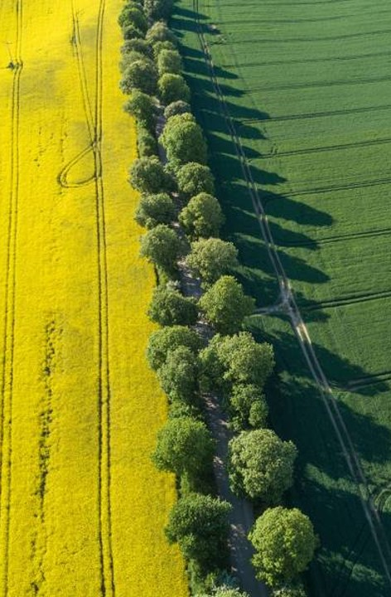
Decision-Making process
Since I worked alone, I carefully thought about what I would truly need to survive in the mountains with limited help. I prioritized items that had multiple uses and could increase my chances of rescue. I ranked everything based on importance to survival and chose the top eight that met my needs for water, warmth, shelter, safety, and rescue.

